Slide 1
CHAPTER 2: Overview of HDL

Slide 2
Syllabus
Week | Content | Notes
1 | Chapter 0: Course Introduction (1) Chapter 1: Introduction to Digital Design (2)
2 | Chapter 2: Overview of HDL (3)
3 | Chapter 3: Basic Language Constructs of VHDL (3)
5, 6 | Chapter 4: Signal Assignment Statements of VHDL (6)
6 | Chapter 5: Combinational Logic Circuit Design (3)
7 | Midterm Exam (2)
8 | Chapter 6: Sequential Logic Circuit Design (3)
9, 10 | Chapter 7: Finite State Machine (FSM) Principle (6)

Slide 3
Content
Hardware Description Languages
Basic VHDL Concept
VHDL in Development Flow
Problem

Slide 4
1. Hardware Description Language
Limitations of traditional programming languages
There are wide varieties of computer programming languages, from Fortran, Pascal to C/C++ to Java/Python/R
Unfortunately, there are not adequate to model digital hardware
Most traditional general-purpose programming languages, such as C/C++, are modeled after sequential process.
In this process, operations are performed in sequential order, one operation at a time.

Slide 5
1. Hardware Description Language
The characteristics of digital hardware are very different from those of the sequential model.
A typical digital system is normally built by smaller parts, with customized wiring that connects the input and output ports of these parts.
When a signal input changes, the parts connected to the signal are activated and a set of new operators is initiated accordingly.
These operations are performed concurrently, and each operation will take a specific amount of time, which represents the propagation delay of a particular part, to complete.
After completion, each part updates the value of the corresponding output port.

Slide 6
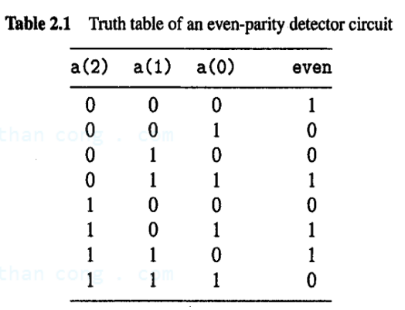
2. Basic VHDL Concept
An example is a circuit that detects even parity.
There are one output, even, and three inputs, a(2), a(1), and a(0), which are grouped as a vector.
The truth table is:

Slide 7
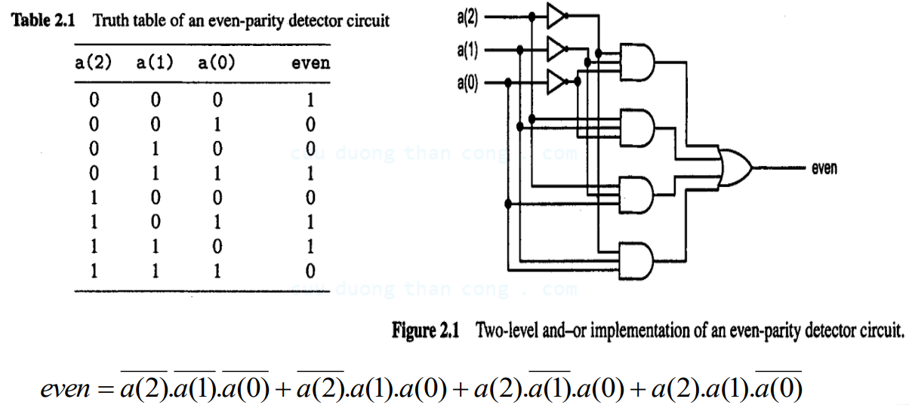
2. Basic VHDL Concept

Slide 8
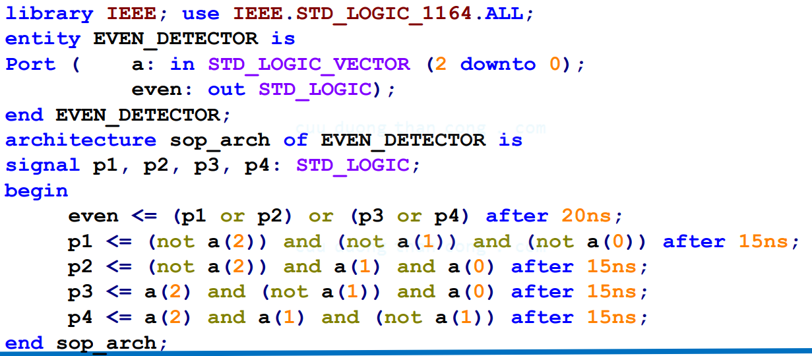
2. Basic VHDL Concept
General Description

Slide 9


2. Basic VHDL Concept
First, two declarations are needed, one for library where the package is located, the other a use clause pointing to the specific package.
Example
IEEE is a standard library that comes with the VHDL development.
When the std_logic (or std_logic_vector) data type is used, the package std_logic_1164 needs to be declared.

Slide 10
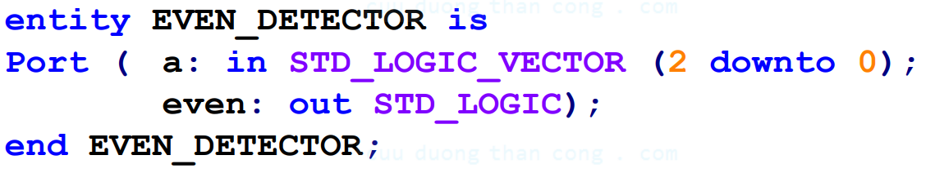
2. Basic VHDL Concept
The code consists of two major units: entity declaration and architecture body.
The entity declaration is:

Slide 11
2. Basic VHDL Concept
The architecture body specifies the internal operation or organization of a circuit.
The next line is the signal declaration

Slide 12
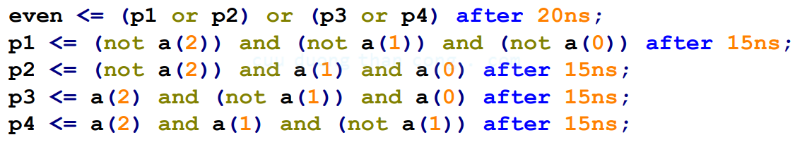
2. Basic VHDL Concept
The fundamental building block inside the architecture body is a concurrent statements.
The left-hand-side signal or port is the output, and all the signals and ports appearing in the right-hand-side expression are the input signals.
After 15ns: indicates that action should occur after a delay of 15ns and only uses for simulation purposes.

Slide 13
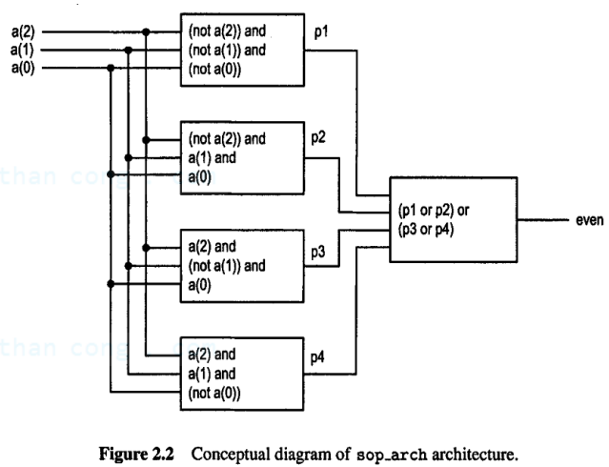
2. Basic VHDL Concept
This architecture body consists of five concurrent statements, which can be interpreted as a collection of five circuit parts.

Slide 14
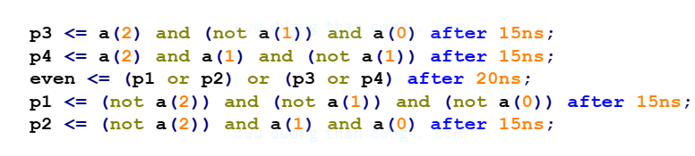
2. Basic VHDL Concept
Note that, the order of these concurrent statements does not matter. For example, we can rearrange the code as

Slide 15
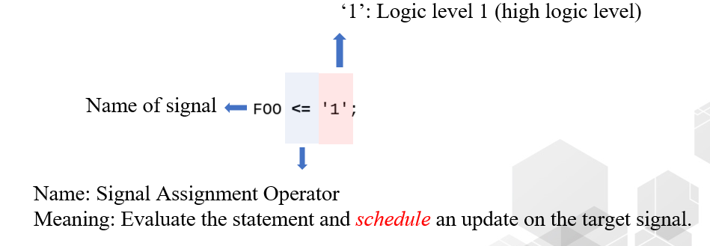
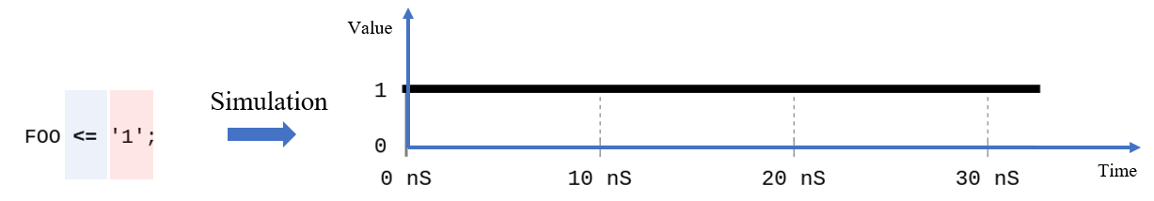
2. Basic VHDL Concept
Signal Assignment Statement

Slide 16
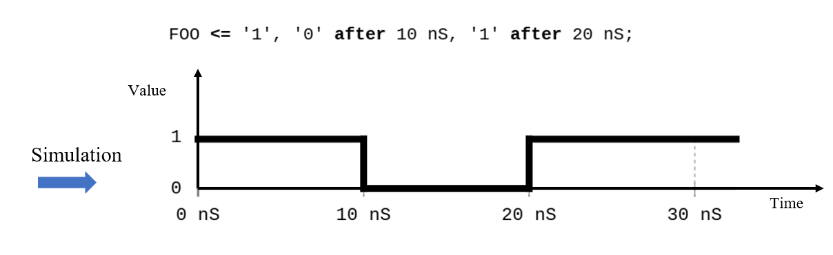
2. Basic VHDL Concept
Signal Assignment Statement

Slide 17
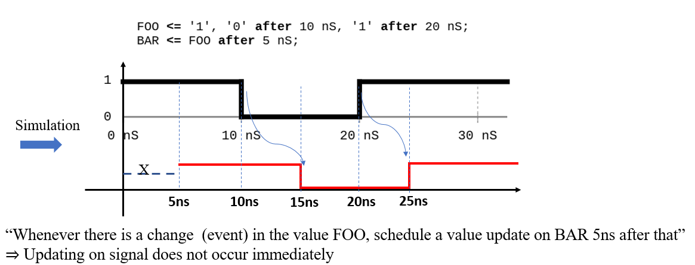
2. Basic VHDL Concept
Signal Assignment Statement

Slide 18
2. Basic VHDL Concept
Signal Assignment Statement

Slide 19
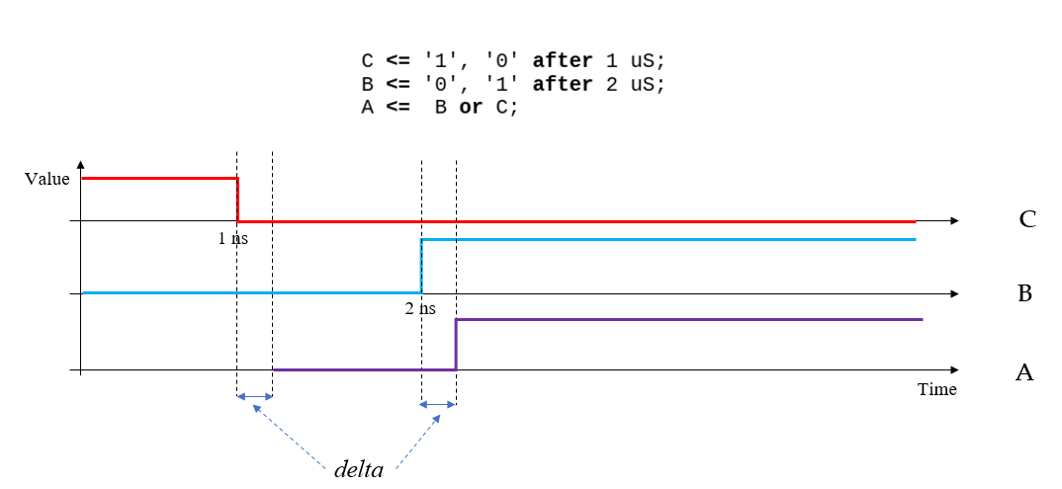
2. Basic VHDL Concept
Signal Assignment Statement
The delta time is the propagation delay in digital circuits and very small.

Slide 20
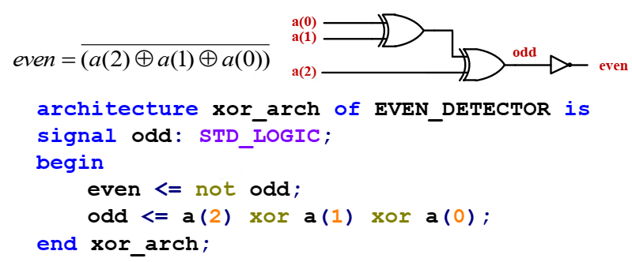
2. Basic VHDL Concept
An alternative is used an XOR operation and the expression can be written as

Slide 21
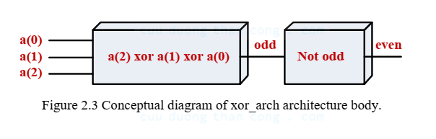
2. Basic VHDL Concept (Structural)
The conceptual diagram is shown in Figure 2.3.
In a structural view, a circuit is constructed of smaller parts.
The description specifies what types of parts are used and how these parts are connected.
The description is essentially a schematic, representing a block diagram or circuit diagram.

Slide 22
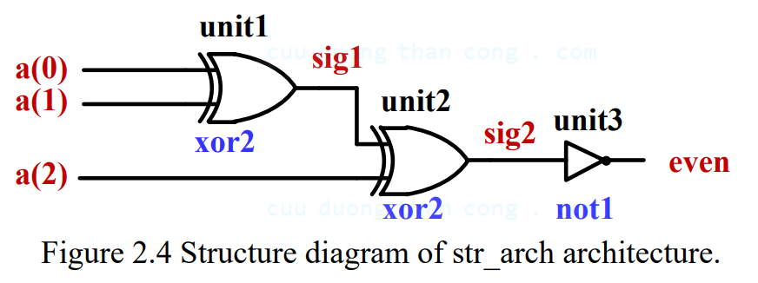
2. Basic VHDL Concept (Structural)
The even-parity detector circuit can be realized by the two parts, as shown in the circuit diagram of Fig. 2.4.
Based on the schematic, a structural description can be derived accordingly.

Slide 23
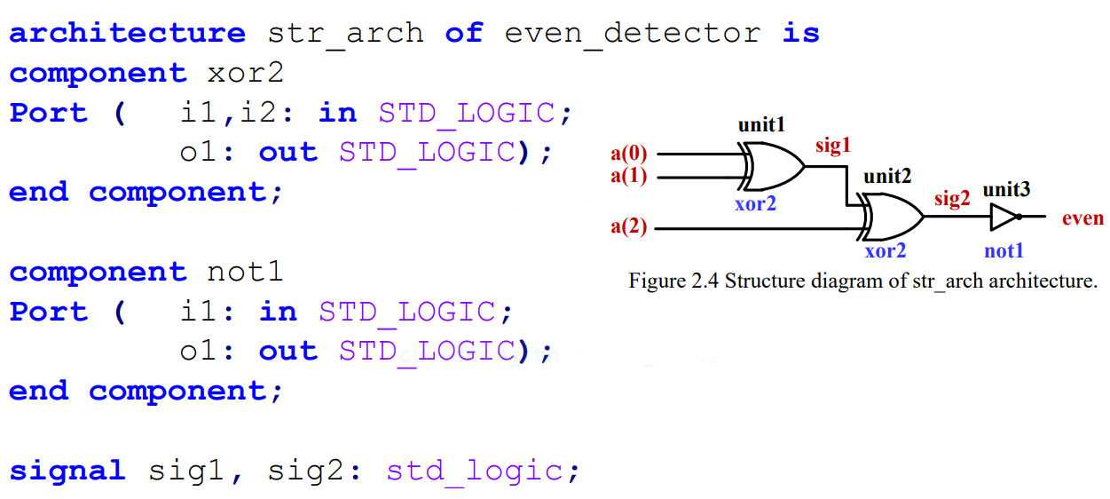
2. Basic VHDL Concept (Structural)

Slide 24
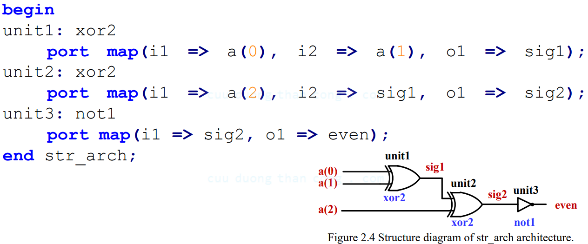
2. Basic VHDL Concept (Structural)

Slide 25
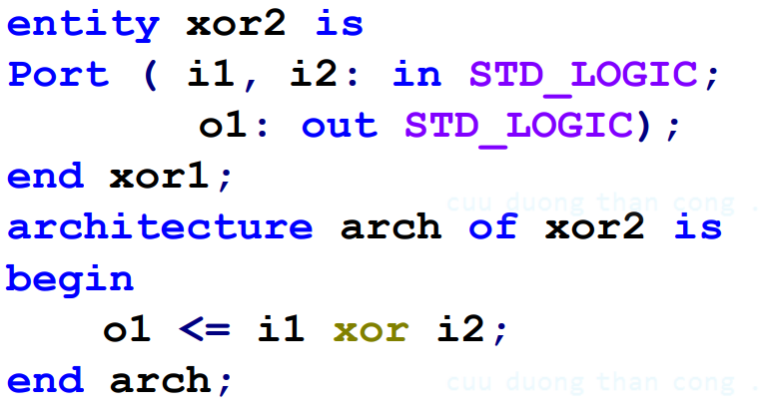
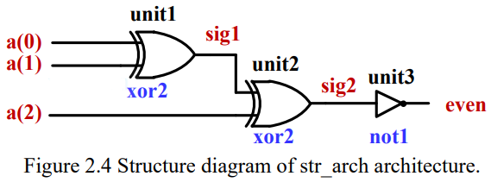
2. Basic VHDL Concept (Structural)

Slide 26
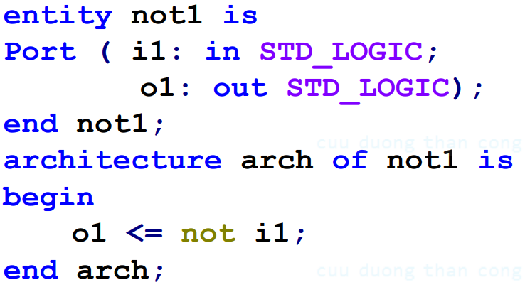
2. Basic VHDL Concept (Structural)

Slide 27
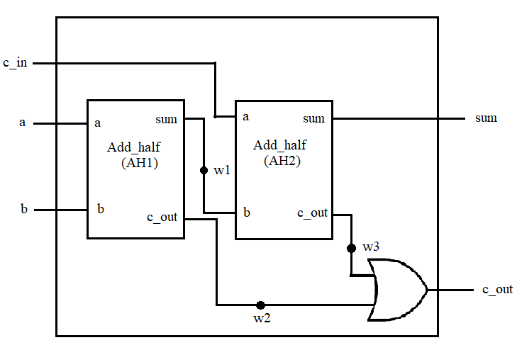
2. Basic VHDL Concept (Structural)
Example: Build up a Full Adder from smaller pieces

Slide 28
2. Basic VHDL Concept (Behavioral)
In a large design, the implement can be very complex and the construction can be time-consuming process.
In the beginning, we frequently just want to study system operation rather than focusing on construction of the actual circuit and prefer an abstract description.
Since human reasoning and algorithms resemble a sequential process, the sequential semantics of traditional language is more adequate.

Slide 29
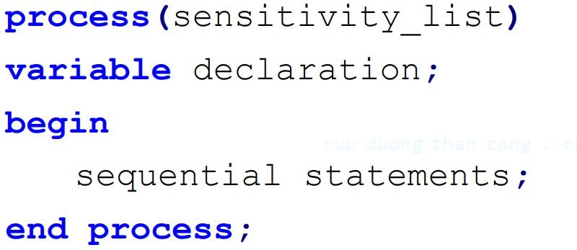
2. Basic VHDL Concept (Behavioral)
VHDL provides language constructs that resemble the sequential semantics, including the use of variable and sequential execution.
These features are considered as exception to the regular VHDL semantics, and they are encapsulated in a special construct, known as a process.

Slide 30
2. Basic VHDL Concept (Behavioral)
A process has a sensitivity list, which is composed of a set of signal.
When a signal in the sensitivity list changes, the process is activated.
Inside the process, the semantic is similar to that of a traditional programming language.
Variables can be used and execution of the statements is sequential.
The use of process is shown in two examples, both describing the even-parity detector circuit.

Slide 31
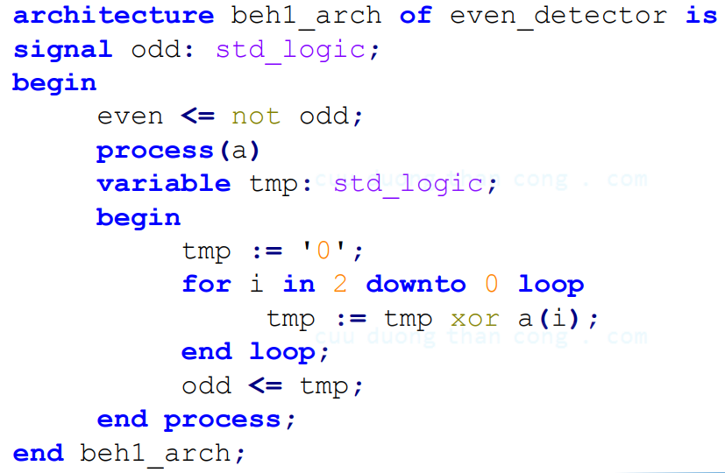
2. Basic VHDL Concept (Behavioral)

Slide 32
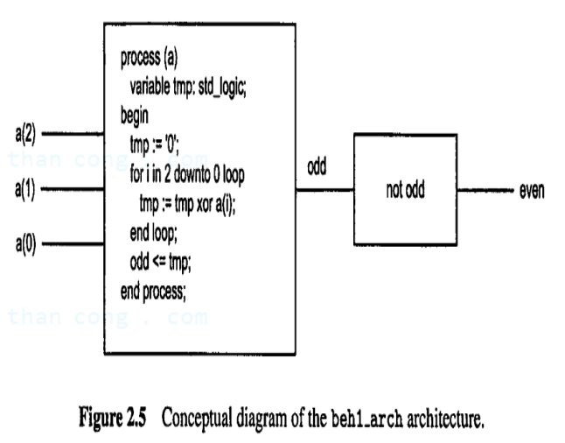
2. Basic VHDL Concept (Behavioral)
The graphic interpretation of the behavioral architecture is shown in Fig. 2.5.

Slide 33
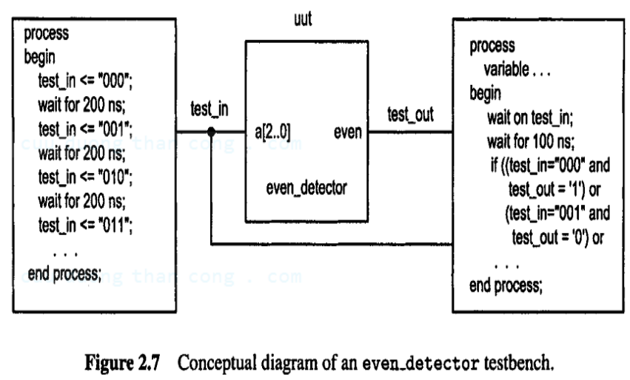
2. Basic VHDL Concept (Testbench)
A simple VHDL testbench for the previous even detection circuit.

Slide 34
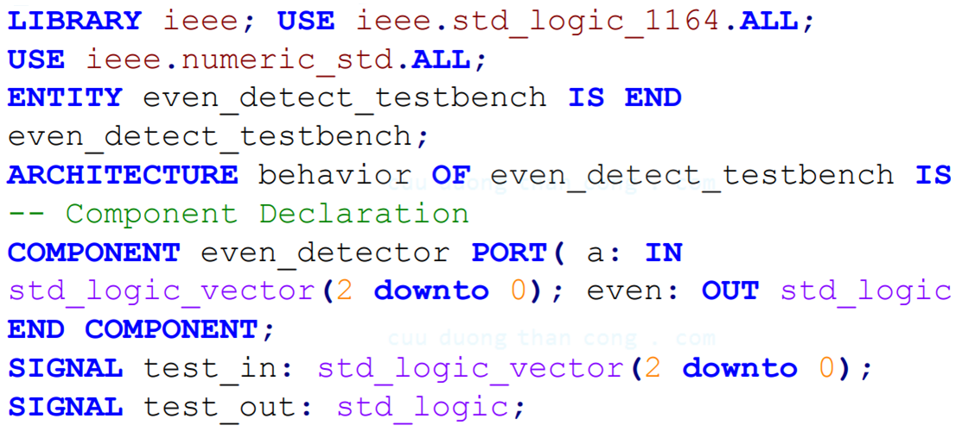
2. Basic VHDL Concept (Testbench)

Slide 35
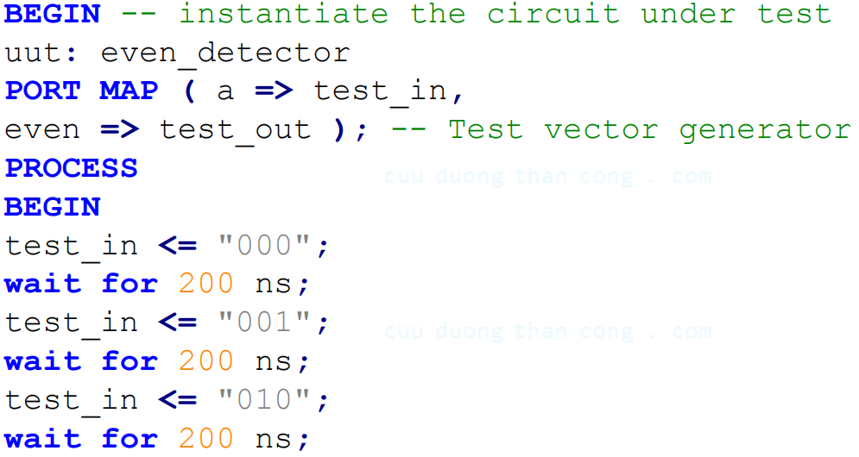
2. Basic VHDL Concept (Testbench)

Slide 36
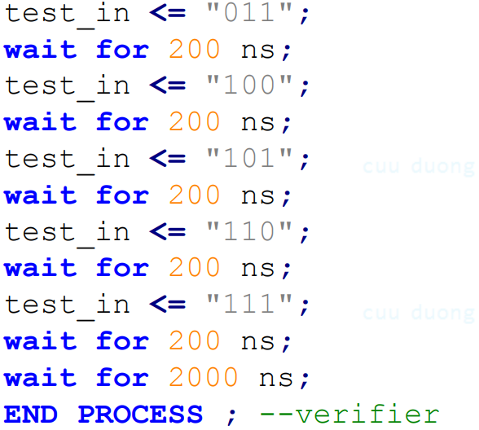
2. Basic VHDL Concept (Testbench)

Slide 37
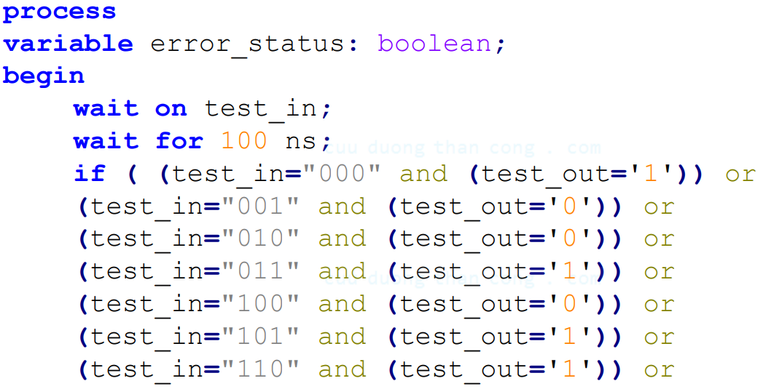
2. Basic VHDL Concept (Testbench)

Slide 38
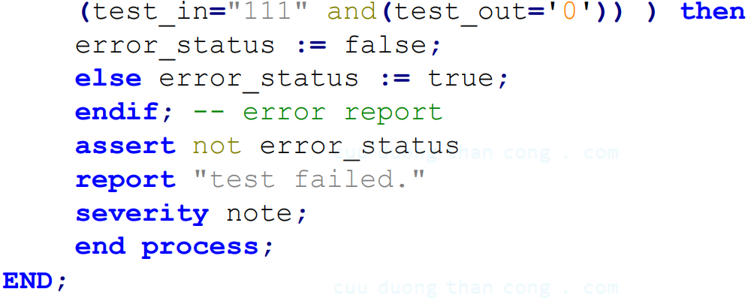
2. Basic VHDL Concept (Testbench)

Slide 39
3. VHDL Development Flow
System Specification
Identify functionality, size, system requirements
Packaging
Package, arrange modules on a complete printed circuit board
Architectural Design
Identify system architecture, for example architecture, number of arithmetic logic units (ALUs), memory size
Fabrication
Manufacture chips using photolithography process and masks
Functional Design
Physical Design
Layout logic components on the chip substrate (in a geometrically sensible manner - Determine the positions of functional blocks + wiring)
Identify system functional blocks
Logic Design
Design functional circuits (combinational circuits, sequential circuits)
Circuit Design
Translate from logic design to logic gates to implement designed functions
(IC Design)

Slide 40
3. VHDL Development Flow
System Requirements
Analyze the requirements of customers, and marketing groups and break them into processing elements and algorithms
Functional Decomposition
Break down the requirements of a design into a set of logic functions that can be used to implement the requirements.
RTL VHDL Model
Converts this description of logic functions and elements into an RTL VHDL model that can be synthesized into logic gates.
Test Bench/Simulation
Simulate the design to confirm the proper functionalities
Logic/Timing Synthesis
Synthesize the logic circuit with logic and timing synthesis
Logic Netlist and Lab Testing
Testing in the laboratory

